Slide 1


GAMA 2022 SECRETARY rEPORT

Slide 2

Agenda
Membership
Sponsorship
Cultural Activities and Events
Sports Tournaments
Community Outreach
Operational Improvements

Slide 3
Membership
How many Memberships did GAMA have in 2022?
251
276
301
314

Slide 4
Sponsorship
How many Sponsors did GAMA have in 2022?
12
22
14
8

Slide 5
Cultural Activities and Events
Inauguration - "രജതരേഖ“: April 30th @ Lassiter High School
Perfectly coincided with GAMA 2022 Motto of “പ്രത്യാശയോടെ മുന്നോട്ട്”, was received by 382 attendees, 60+ Participants
Michelle Au, The Chief Guest, along with Past Presidents have been honored during the Program
Onam - "കേരളോത്സവം“: August 20th @ Mountain View High School
GAMA Onam was the 1st 2022 Onam in Atlanta, was received by 1021 attendees, punctuated by 160+ onstage performers and delicious Onasadya. 80% of the participants were Teenagers/Kids from next Generation
Long time GAMA Sponsors have been honored
Christmas - "ക്രിസ്മസ് സായാഹ്നം“: December 03rd @ Mountain View High School
Journey - to - Bethlehem Theme, 16 Programs are scheduled, received by 512 RSVP’s attendees and 150+ participants on stage
Compered and Mostly decorated by our next generation teenagers, Kids: Biggest Testimony that we are empowering our Next Gen in a transitioning GAMA Values
GAMA Most Valuable Volunteers from 2022, GAMA Malayalam Academy Volunteers are honored

Slide 6
How many Sadyas were served for 2022 Onam?
990
1189
1021
1204

Slide 7
Sports and Outdoor Events
GAMA Picnic
28 Card Game Tournament
56 Card Game Tournament
Rummy Card Game Tournament
Bikers Club
Badminton: Include one Teen Team, One Mixed Team
Volleyball: Include one team with 2nd/3Rd Generation youth under 25 years of age
Soccer: Includes two teams with 1st/2nd Generation youth under 20 years of age
Engaged over 400+ attendees/Participants through these programs. Again a clear indication of engaging Next Generation and Passing GAMA Value to the Next Generation.

Slide 8
Community Outreach
Resuming Malayalam Academy
Hands on Volunteering (Food For Life, Food Drive for Clarkston Community)
GAMA Adopt-A-Road Program – successfully executed for 4 Quarters
College Readiness – Buddy Program
Malayalam Book Drive for Forsyth County
Bikers Club
Seniors Reconnect
Participation in third party events
Engaged over 150+ attendees/Participants through these programs. First 4 Outreach Programs were intended at the Teens and Youth and had an amazing turn out. Another successful way to pass GAMA value

Slide 9
How many Quarters GAMA have to maintain Adopt-A-Road Program, to attain the Road named against GAMA?
4
10
8
12

Slide 10
Operational Improvements
RSVP based Cultural Events
ZERO Food Wastage across 3 Events (Inauguration, Onam, Christmas)
SMS based Telemarketing for GAMA events
Enabled Zelle Transactions easy payment
Minimal Front Desk Waiting time
Maintained a self driven Teens/Kids volunteer group for Adopt-A-Road Program
Maintained a Self Driven Teens Volunteer group for Front Desk (Inauguration, Onam)
Teens/Kids oriented cultural events

Slide 11
Can anyone guess what’s our estimated Financial Surplus this year is?
$2000
$500
$1000
$1500

Slide 12
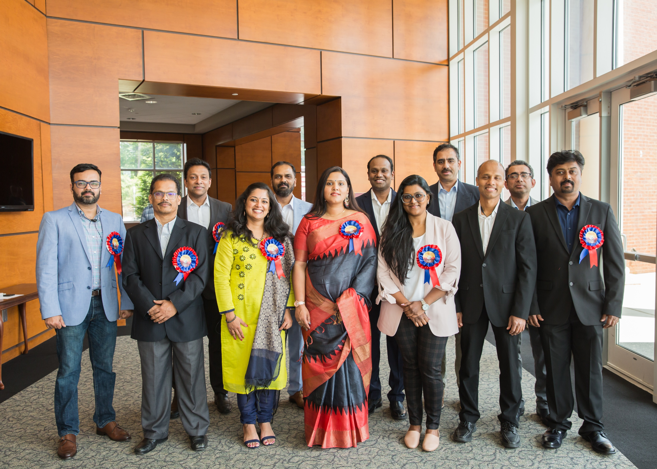
Our Team
Shajeev Padmanivas: President Srija Kulakizha: Vice President Binu Kasim: Secretary Tony Thomas: Joint Secretary John Mathai: Treasurer Jayamon Nedumpurath: Chair Malayalam Academy Anil Nair: Chair Charity Initiative, Food and Refreshments Manoj Varghese: Chair Sports, Cultural Program Geethu Venugopal: Director Cultural Events Shaji Kamalasanan: Asst: Director Cultural Events Supriya Namboodiri: Director Women, Senior/Youth Forum Harish Velayudhan: Director Information Technology Nelson Parappully: Director Information Technology

Slide 13
General Body Agenda/Resolutions
All transition Milestones to be reviewed and approved by BOT
Financial Accounts to be reviewed and approved by BOT
Any Status Changes to GAMA PO. BOX and/or Storage requires approval from both BOT and General Body
Any Money withdrawal from CD Account requires approval from both BOT and General Body
All Ever-Rolling Trophies requires to be collected in the same Executive Year
FYI: GAMA Building initiatives will be undertaken between BOT and 2023 Executive Committee.

Slide 14
THANK YOU EVERYONE!!!
GAMA 2022

